Slide 1
Object Oriented Programming Lecture-19
Static vs Dynamic Binding, Method Hiding. Private and final methods
Prof. Varsha Dange

Slide 2
Static Binding or Early Binding in Java
Static Binding or Early Binding in Java refers to a process where the compiler determines the type of object and resolves the method during the compile-time.
Generally, the compiler binds the overloaded methods using static binding.
binding of static, private, and final methods are always done during compile-time using static-binding.

Slide 3
Static Binding or Early Binding in Java
Example
From the above code, we got the same output from the parent class. This happened because:
The reference for the parent class and the child class is the same .That is, a single object refers to both of them.
Since the method is static, the compiler is aware that this method can not be overridden in the child class and it knows which method to call.
Therefore there is no ambiguity and the output is the same for both cases.

Slide 4
Why is the binding of static, final and private methods always a static binding?
the compiler determines the type of the class at the compile-time and therefore we can not override them during the runtime.
Another reason is that the static binding of methods provides better performance than the runtime binding.
The compiler becomes aware of these methods and understands that method overriding is not possible with such methods.
Therefore, binding of these methods always takes place during compilation.

Slide 5
Dynamic or Late Binding in Java
When the compiler resolves the method call binding during the execution of the program,
such a process is known as Dynamic or Late Binding in Java.
The type of object is determined during the execution of the program, therefore it is called dynamic binding.
Overriding is a perfect example of dynamic binding.
In overriding both parent and child classes have same method
And, therefore the type of the object determines which method is going to be executed.
Example

Slide 6
Dynamic or Late Binding in Java
Methods are not static in this code.
During compilation, the compiler has no idea as to which print has to be called since compiler goes only by referencing variable
not by type of object and
therefore the binding would be delayed to runtime and
therefore the corresponding version of print will be called.

Slide 7
Dynamic or Late Binding in Java
private, final and static members (methods and variables) use static binding .
Static binding uses Type information for binding
while Dynamic binding uses Objects to resolve binding.
Overloaded methods are resolved using static binding at compile time.
while overridden methods using dynamic binding, i.e, at run time.

Slide 8
S.N. | Static Binding | Dynamic Binding
1. | A type of polymorphism that collects the information to call a method during the compile-time. | A type of polymorphism that collects the information to call a method at the runtime.
2. | The binding happens at compile time. | The binding happens at runtime.
3. | The actual object is not used for binding. | The actual object is used for binding.
4. | It is also called early binding because binding happens during compilation. | It is also called late binding because binding happens at run time.
5. | The execution speed is high. | The execution speed is slow.
6. | Method overloading is the best example of static binding. | Method overriding is the best example of dynamic binding.
7. | The methods which are private, static and final, show static binding because we can not override them. | The methods other than private, static and final methods show dynamic binding because overriding is possible with these methods.

Slide 9
method hiding in Java
A static method (class method) cannot be overridden in Java.
But if a static method defined in the parent class is redefined in a child class, the child class’s method hides the method defined in the parent class.
This mechanism is called method hiding in Java or function hiding.

Slide 10
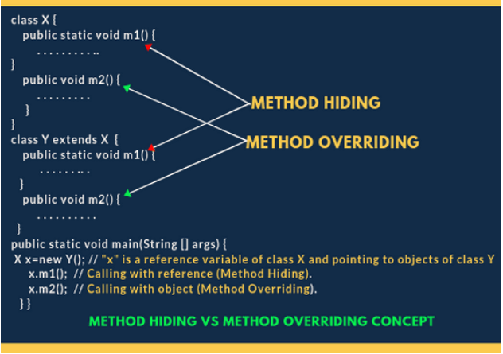
Rules of Method Hiding in Java
1. Both parent and child class methods must be static.

Slide 11
Features of Method Hiding in Java
1. Method hiding is also known as compile-time polymorphism
because the compiler is responsible to resolve method resolution based on the reference type.
2. It is also known as static polymorphism or early binding.
3. In method hiding, method call is always resolved by Java compiler based on the reference type.
There is no role of runtime polymorphism in method hiding in java.
4. The use of static in method declaration must be the same between superclass and subclass.

Slide 12
Features of Method Hiding in Java
Key points:
1. In method overriding, method call is resolved by JVM based on runtime object (new Object).
2. In method hiding, method call is resolved by the compiler based on reference type (Object obj).
Example1
Example2
Example3
Example
In Example : we cannot reduce the visibility of method
1. x.m1(10); will call m1() method of class X because x is a reference type of X.
2. y.m1(20); will give a compile-time error because we cannot reduce the visibility of the inherited method from X.

Slide 13
Difference between Method Hiding and Method Overriding
1. In method hiding, both parent and child class methods should be static whereas, in overriding, both parent and child class methods should be non-static.
2. Compiler is responsible for method resolution based on reference type whereas, in method overriding, JVM is always responsible for method resolution based on runtime object.
3. Method hiding is also known as compile-time polymorphism, static polymorphism, or early binding whereas, method overriding is also known as runtime polymorphism, dynamic polymorphism, or late binding.

Slide 14
Variable Hiding in Java
When a variable defined in the parent class is redefined with the same name in a child class, the child class’s variable hides variable defined in the parent class.
This mechanism is called variable hiding in Java.
It can be achieved by declaring a variable in child class that must be the same name and type of an inherited variable from its parent class.
Variable hiding is useful when you want to reuse the same variable name in the subclass.
Example1
Example2

